Slide 1
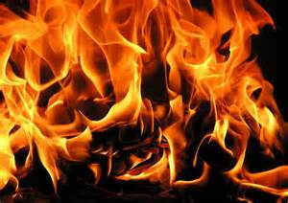

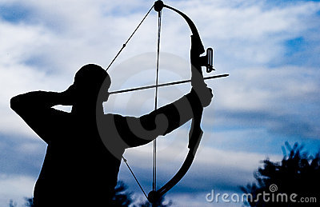

Judging a book by its cover
Learning Objectives: To understand what we are going to be studying by making inferences.
1
Starter:
Look at these pictures. What does each of them symbolise? [List as many things as you can in your books]
2
3
A symbol is something which people recognise as representing a specific meaning, theme or event.
Challenge: These images are all connected to what we will be studying this half term.
What do you think the key themes are going to be?
4
Notes:
1

Slide 2




Learning Objective: To think about the importance of appearances…
“Don’t judge a book by its cover.” Do you agree with this quotation?
Imagine you’re a book publisher, which of these would you select and why?
What do you think this book is going to be about?
Notes:
2

Slide 3
Learning Objective: To think about the importance of appearances…
“Don’t judge a book by its cover.”
In groups, we are going to analyse one of these book covers.
Be ready to feed back to the class…
Notes:
3

Slide 4
Learning Objective: To understand what we will be studying
What are the main colours? Why have they been used?
What images or symbols can you see on your front cover? What do they represent?
What are the key themes of the book?
What can you infer about the storyline of the book?
How is this book cover persuasive?
Notes:
Group 1 – stick as A4 on sugar paper and groups answer the questions round the edges of the page. Consider group roles.
4

Slide 5
Learning Objective: To understand what we will be studying
What are the main colours? Why have they been used?
What images or symbols can you see on your front cover? What do they represent?
What are the key themes of the book?
What can you infer about the storyline of the book?
How is this book cover persuasive?
Notes:
Group 2 – stick as A4 on sugar paper and groups answer the questions round the edges of the page. Consider group roles.

Slide 6
Learning Objective: To understand what we will be studying
What are the main colours? Why have they been used?
What images or symbols can you see on your front cover? What do they represent?
What are the key themes of the book?
What can you infer about the storyline of the book?
How is this book cover persuasive?
Notes:
Group 3 – stick as A4 on sugar paper and groups answer the questions round the edges of the page. Consider group roles.

Slide 7
Learning Objective: To understand what we will be studying
What are the main colours? Why have they been used?
What images or symbols can you see on your front cover? What do they represent?
What are the key themes of the book?
What can you infer about the storyline of the book?
How is this book cover persuasive?
Notes:
Group 4 – stick as A4 on sugar paper and groups answer the questions round the edges of the page. Consider group roles.

